Slide 1
U-MAS
University Material & Attendance System

Slide 2
Members
Mohit Vadaliya 206540307073
Harmin Rana 206540307074
Dhrumil Rupakar 206540307109
Khush Siddhpura 206540307136
Honourable Mention:-
Mr. Tushar Oza

Slide 3
Our team
Definition
01.
02.
03.
The project
Requirements
Project goals
Making availability of college life more trouble-free
Your attendance
To change your college life
04.
05.
Stages
From attendance to material we desire to go further
Most dedicated people you will meet

Slide 4
What are we working on?
Solution
Vision
To come up with reliable solution for management
To make college life hassle free
Attendance
To make attendance management effortless

Slide 5
About the project

Slide 6
What we solve
Always have to worry about your attendance and new circular about upcoming events and news?Well now that’s over, you don’t have to worry about all that.
We are here to solve all your worries

Slide 7
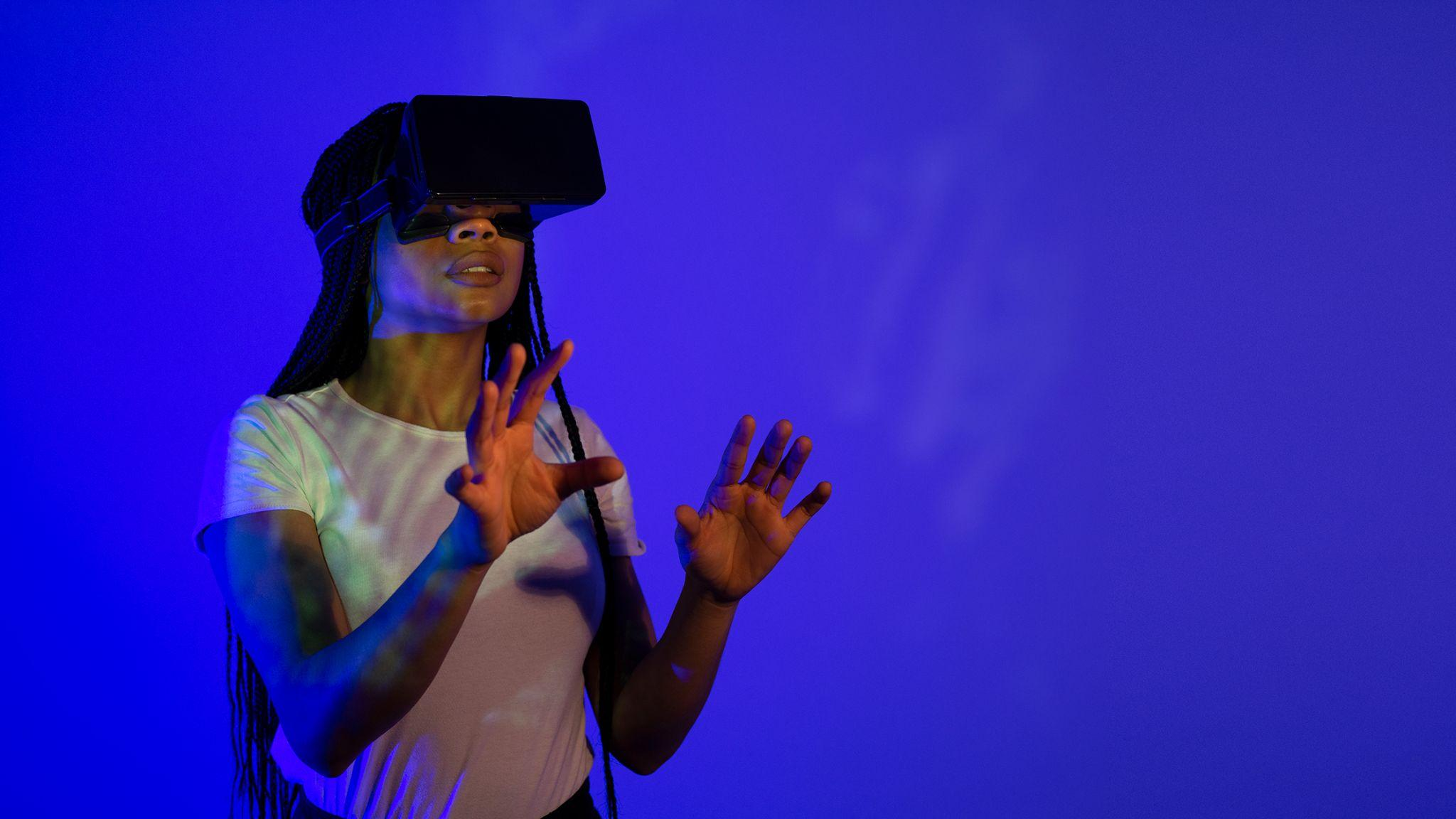
Our purpose
We are willing to serve our idea in front of you, while making your teaching life more easy and tension less and all on your fingertips. We are trying to provide a platform for all your attendance related problem and to try reducing all the complexity a teacher have to go through all his/her teaching life.

Slide 8


What we are
We are trying to serve a best and easy way of accessing all your management system you need for managing the whole class and even whole college and school with your fingertip.

Slide 9
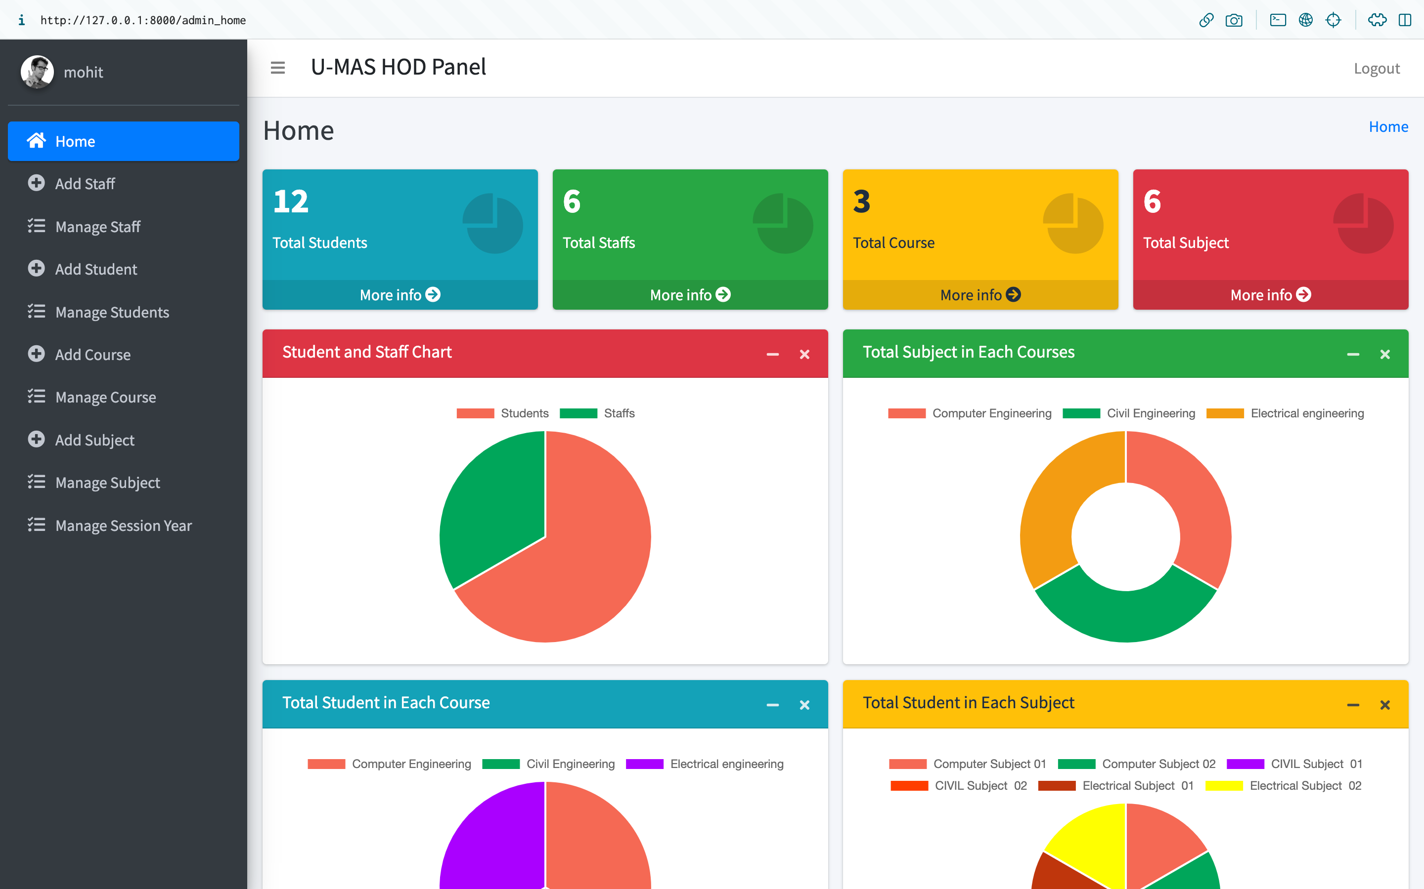
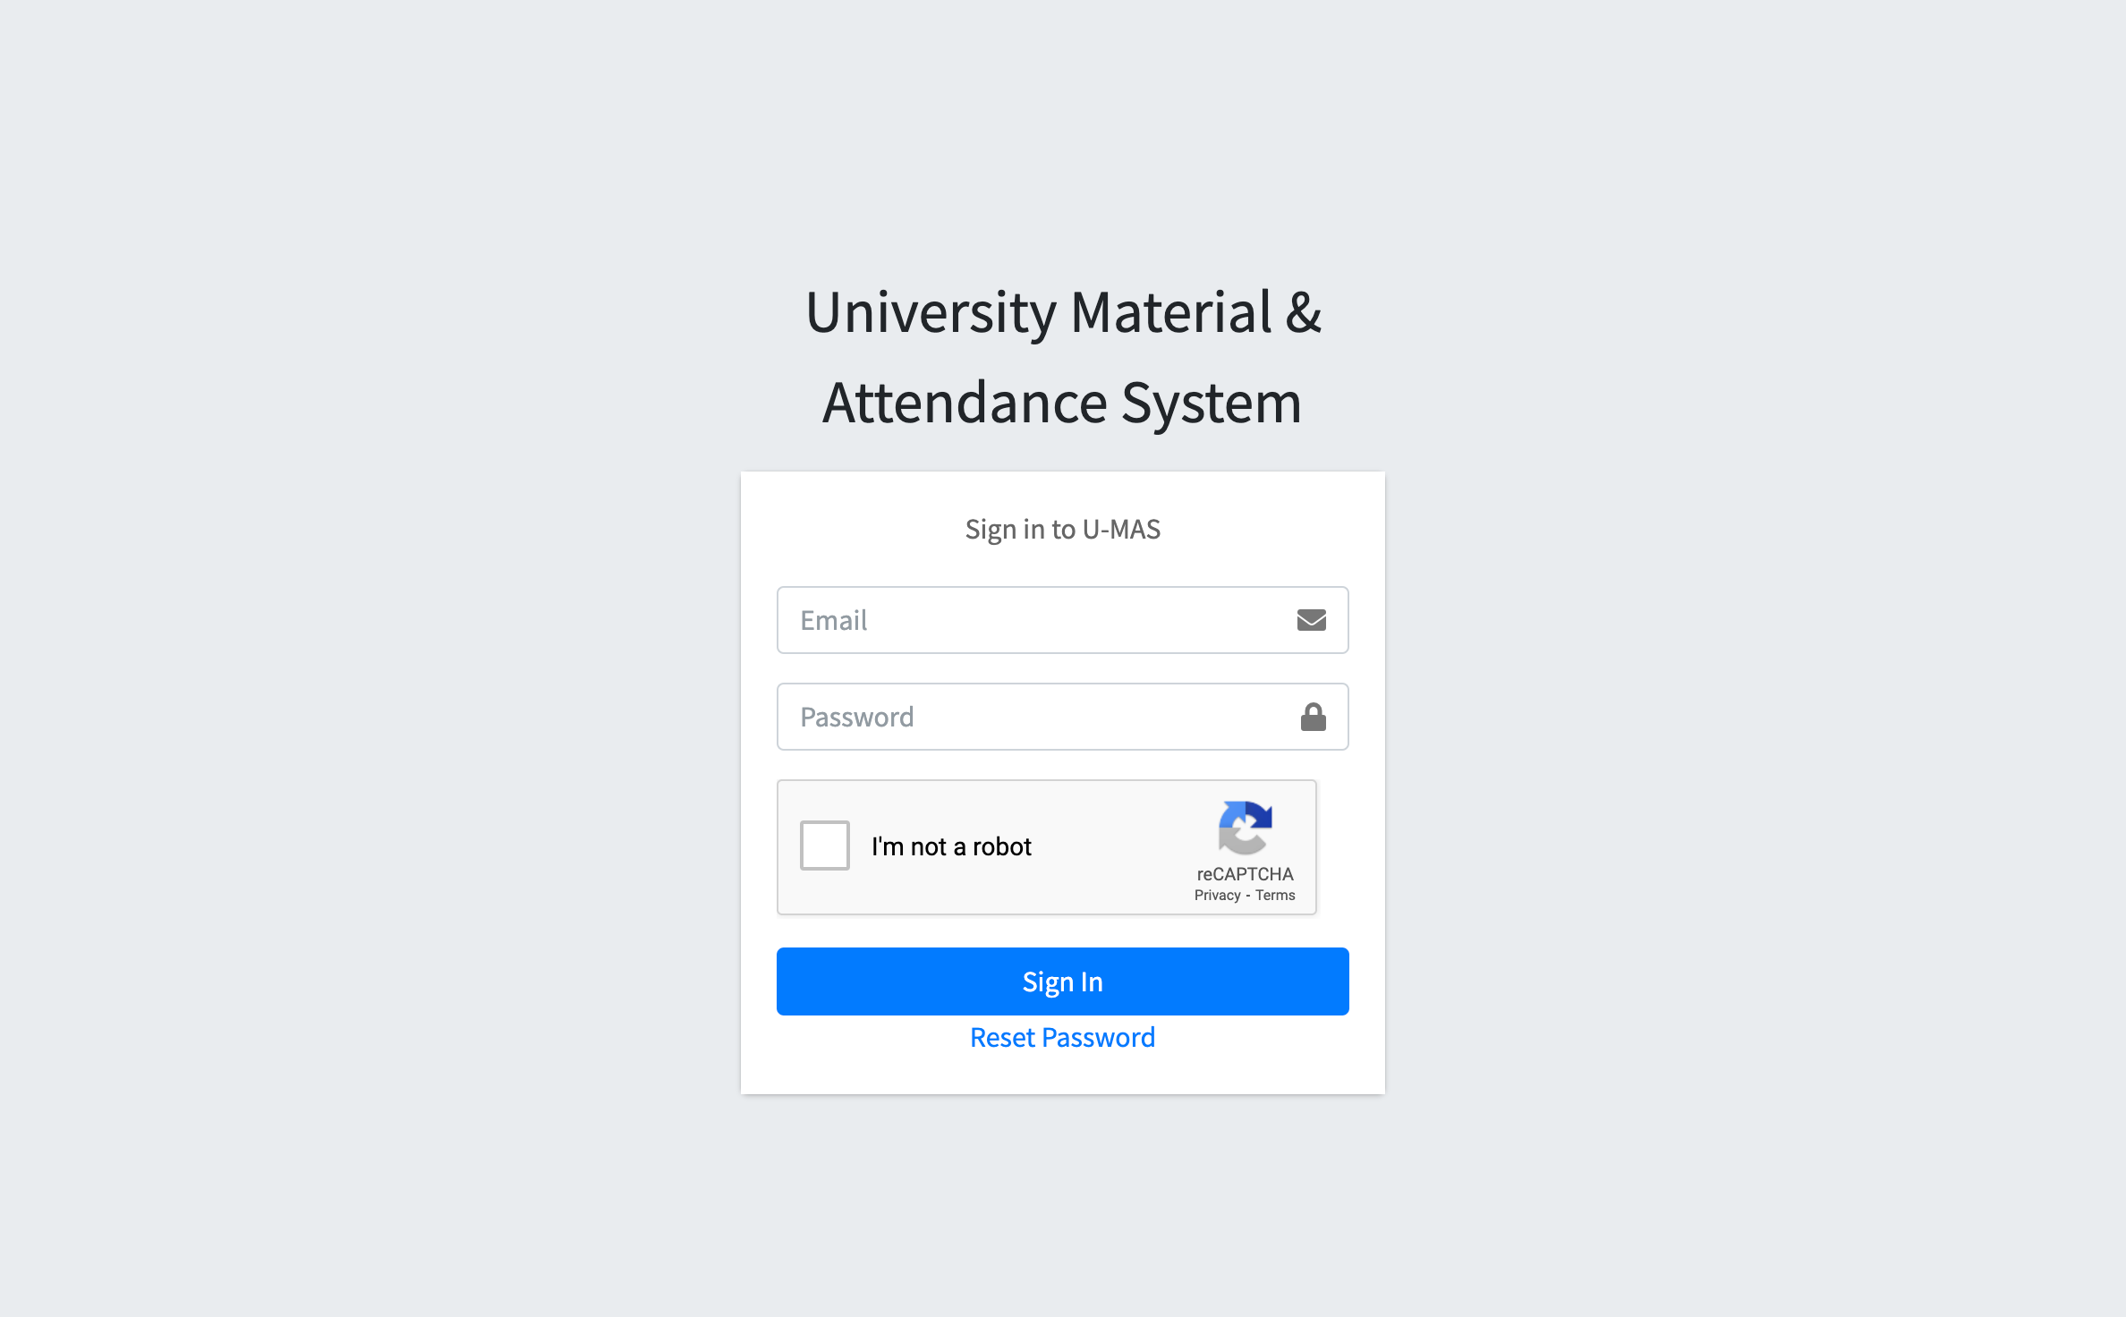
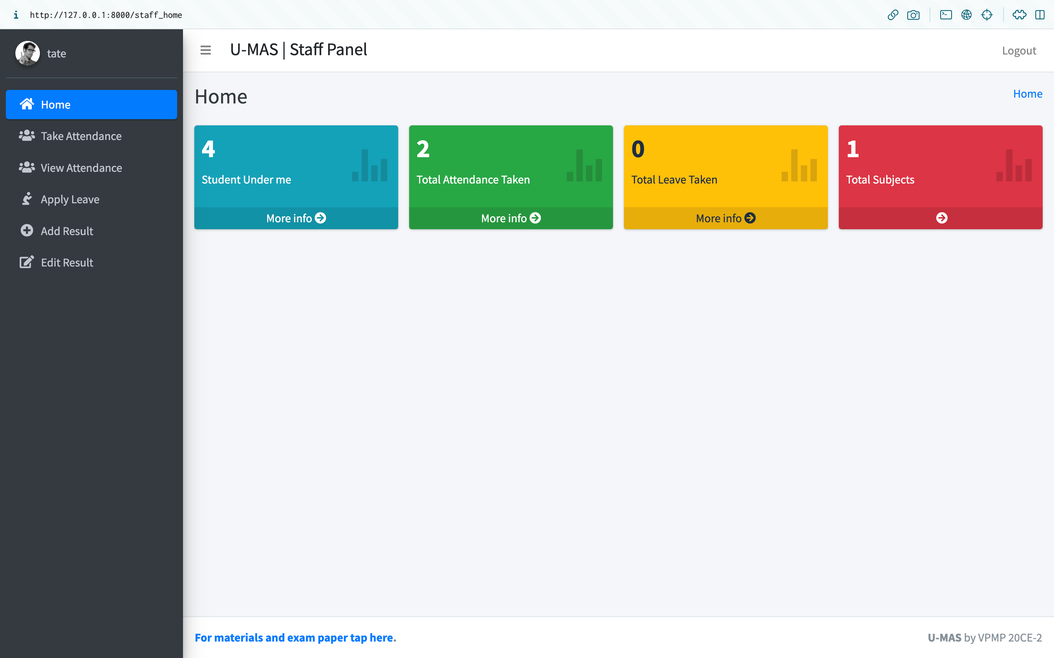
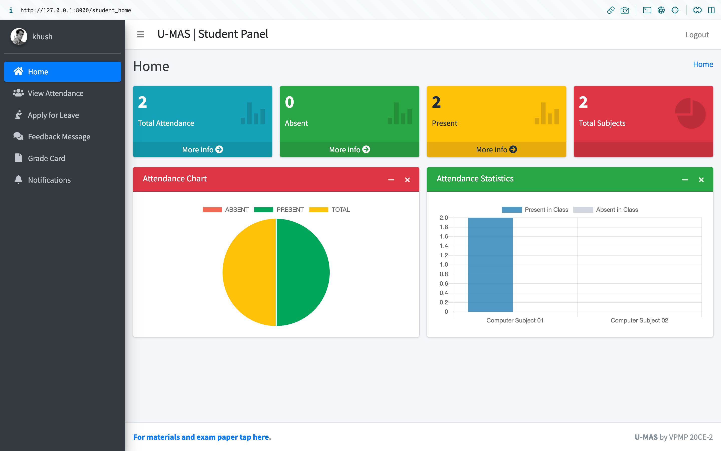
UI of our website
Log-in page
HOD home page
Staff home page
Student home page

Slide 10




Resources
Used

Slide 11

LINKS AND ARTICLES
Language - Python, Html, Css.
Framework - Django.
Template - AdminLTE 3 with bootstrap
Database - SQLite3
Additional technology- Sass Css.

Slide 12



Software utilised
About Django framework
Django is a high-level Python web framework that enables rapid development of secure and maintainable websites. Built by experienced developers, Django takes care of much of the hassle of web development, so you can focus on writing your app without needing to reinvent the wheel
We have used Python3.11.2 with its amazing framework called “Django”.
It provides all the functionality which helps the developer to create amazing websites.

Slide 13
Future
We are planning to add a hassle free management for all the attendance work a teacher has to suffer with.

Slide 14
Thank You!
And that brings us to the end, Thanks for your interest and attention we are glad to have you all here and we really appreciate your presence.

